Slide 1
Collections 2

Slide 2
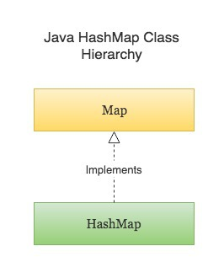
HashMap
Java HashMap is a hash table based implementation of Java’s Map interface. A Map, as you might know, is a collection of key-value pairs. It maps keys to values.
Following are few key points to note about HashMaps in Java -
A HashMap cannot contain duplicate keys.
Java HashMap allows null values and the null key.
HashMap is an unordered collection. It does not guarantee any specific order of the elements.
Java HashMap is not thread-safe. You must explicitly synchronize concurrent modifications to the HashMap.

Slide 3
Create HashMap
import java.util.HashMap;
import java.util.Map;
public class CreateHashMapExample {
public static void main(String[] args) {
// Creating a HashMap
Map<String, Integer> numberMapping = new HashMap<>();
// Adding key-value pairs to a HashMap
numberMapping.put("One", 1);
numberMapping.put("Two", 2);
numberMapping.put("Three", 3);
// Add a new key-value pair only if the key does not exist in the HashMap, or is mapped to `null`
numberMapping.putIfAbsent("Four", 4);
System.out.println(numberMapping);
}
}
# Output
{One=1, Four=4, Two=2, Three=3}

Slide 4
HashMap entrySet() Method in Java
The java.util.HashMap.entrySet() method in Java is used to create a set out of the same elements contained in the hash map. It basically returns a set view of the hash map or we can create a new set and store the map elements into them.

Slide 5
keySet() vs entrySet vs values() Example in Java Map
The java.util.Map interface provides three methods keySet(), entrySet() and values() to retrieve all keys, entries (a key-value pair), and values. Since these methods directly come from the Map interface, you can use it with any of the Map implementation class e.g. HashMap, TreeMap, LinkedHashMap, Hashtable, ConcurrentHashMap, and even with specialized Map implementations like EnumMap, WeakHashMap, and IdentityHashMap.
Notes:
Hash table based implementation of the Map interface, with weak keys. An entry in a WeakHashMap will automatically be removed when its key is no longer in ordinary use. More precisely, the presence of a mapping for a given key will not prevent the key from being discarded by the garbage collector, that is, made finalizable, finalized, and then reclaimed. When a key has been discarded its entry is effectively removed from the map, so this class behaves somewhat differently from other Map implementations.
Weak Hashmap This class implements the Map interface with a hash table, using reference-equality in place of object-equality when comparing keys (and values). In other words, in an IdentityHashMap, two keys k1 and k2 are considered equal if and only if (k1==k2). (In normal Map implementations (like HashMap) two keys k1 and k2 are considered equal if and only if (k1==null ? k2==null : k1.equals(k2)).)
IdentityHashMap as name suggests uses the equality operator(==) for comparing the keys. So when you put any Key Value pair in it the Key Object is compared using == operator. On the other hand HashMap uses equals method to determine the uniqueness of the Key.
IdentityHashMap as name suggests uses the equality operator(==) for comparing the keys. So when you put any Key Value pair in it the Key Object is compared using == operator.
import java.util.HashMap; import java.util.IdentityHashMap; import java.util.Map;public class IdentityMapDemo {public static void main(String[] args) { Map identityMap = new IdentityHashMap(); Map hashMap = new HashMap(); identityMap.put("a", 1); identityMap.put(new String("a"), 2); identityMap.put("a", 3);hashMap.put("a", 1); hashMap.put(new String("a"), 2); hashMap.put("a", 3);System.out.println("Identity Map KeySet Size :: " + identityMap.keySet().size()); System.out.println("Hash Map KeySet Size :: " + hashMap.keySet().size()); } }
On the other hand HashMap uses equals method to determine the uniqueness of the Key.
k1.equals(k2)
instead of equality operator.
When you run the above code the result will be
Identity Map KeySet Size :: 2Hash Map KeySet Size :: 1
The Keysize of Identity Map is 2 because here a and new String(“a”) are considered two different Object. The comparison is done using == operator.
For HashMap the keySize is 1 because K1.equals(K2) returns true for all three Keys and hence it keep on removing the old value and updating it with the new one.
These both Maps will behave in same manner if they are used for Keys which are user defined Object and doesn’t overrides equals method.
<number>

Slide 6
The keySet() method
This method returns a Set view of all the keys in the map. The set is backed by the map, so changes to the map are reflected in the set, and vice-versa. If the map is modified while an iteration over the Set is in progress (except through the iterator's own remove operation), the results of the iteration are undefined.
The set supports element removal, which removes the corresponding mapping from the map, via the Iterator.remove(), Set.remove(), removeAll(), retainAll(), and clear() operations, but It does not support the add() or addAll() operations.

Slide 7
Keyset()
You can also use the keySet() method to iterate over a Java HashMap as shown in the following example:
// Iterating using keySet() method of HashMap
Set<String> keys = priceMap.keySet();
for(String key: keys){
Integer value = priceMap.get(key);
System.out.printf("key: %s, value: %d %n", key, value);
}
Output:
key: Car, value: 20000
key: Phone, value: 200
key: Bike, value: 6000
key: Furniture, value: 700
key: TV, value: 500

Slide 8
The entrySet() method
The entrySet() method of Map interface returns a Set view of the mappings contained in this map. The set is backed by the map, so changes to the map are reflected in the set, and vice-versa. If the map is modified while an iteration over the set is in progress (except through the iterator's own remove operation, or through the setValue() operation on a map entry returned by the iterator) the results of the iteration are undefined. The Set also supports element removals, which removes the corresponding mapping from the map, via the Iterator.remove(), Set.remove(), removeAll(), retainAll(), and clear() operations. It does not support the add() or addAll() operations.

Slide 9
The entrySet() method
Here is an example of how you can traverse over a Map in Java using the entrySet() method. This is by far the most efficient way of iterating over Map out of several ways we have discussed earlier.
// traversing Map using entrySet() method
Set<Entry<String, Integer>> entries = priceMap.entrySet();
for(Map.Entry<String, Integer> entry : entries){
String key = entry.getKey();
Integer value = entry.getValue();
System.out.printf("key: %s, value: %d %n", key, value);
}

Slide 10
The values() methods
The values() methods of Map interface returns a Collection view of the values contained in this map. The collection is backed by the map, so changes to the map are reflected in the collection, and vice-versa.
If the map is modified while an iteration over the collection is in progress (except through the iterator's own remove operation), the results of the iteration are undefined. The collection supports element removal, which removes the corresponding mapping from the map, via the Iterator.remove(), Collection.remove(), removeAll(), retainAll() and clear() operations.
Similar to keySet() and entrySet(), It does not support the add() or addAll() operations.
Here is how you can get all the values from a Map in Java:
Collection<Integer> values = priceMap.values();

Slide 11
Java Program to use keySet(), entrySet() and values()
import java.util.Collection;
import java.util.HashMap;
import java.util.Map;
import java.util.Map.Entry;
import java.util.Set;
public class HashMapDemo {
public static void main(String[] args) {
Map<String, Integer> priceMap = new HashMap<>();
priceMap.put("TV", 500);
priceMap.put("Phone", 200);
priceMap.put("Car", 20000);
priceMap.put("Bike", 6000);
priceMap.put("Furniture", 700);
System.out.println("price map: " + priceMap);
Set<String> keys = priceMap.keySet();
Collection<Integer> values = priceMap.values();
Set<Entry<String, Integer>> entries = priceMap.entrySet();
System.out.println("keys of Map : " + keys);
System.out.println("values from Map :" + values);
System.out.println("entries from Map :" + entries);
}
}
Output:
price map: {Car=20000, Phone=200, Bike=6000, Furniture=700, TV=500}
keys of Map : [Car, Phone, Bike, Furniture, TV]
values from Map :[20000, 200, 6000, 700, 500]
entries from Map :[Car=20000, Phone=200, Bike=6000, Furniture=700, TV=500]

Slide 12
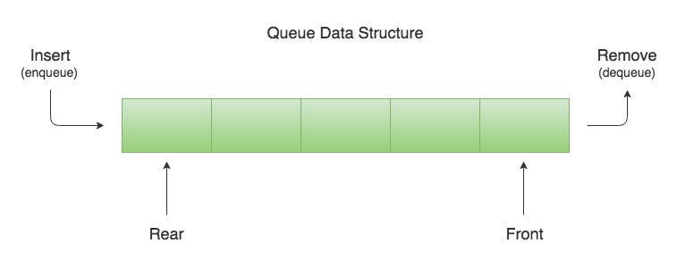
Queue
A Queue is a First In First Out (FIFO) data structure. It models a queue in real-life. Yes, the one that you might have seen in front of a movie theater, a shopping mall, a metro, or a bus.
Just like queues in real life, new elements in a Queue data structure are added at the back and removed from the front. A Queue can be visualized as shown in the figure below

Slide 13
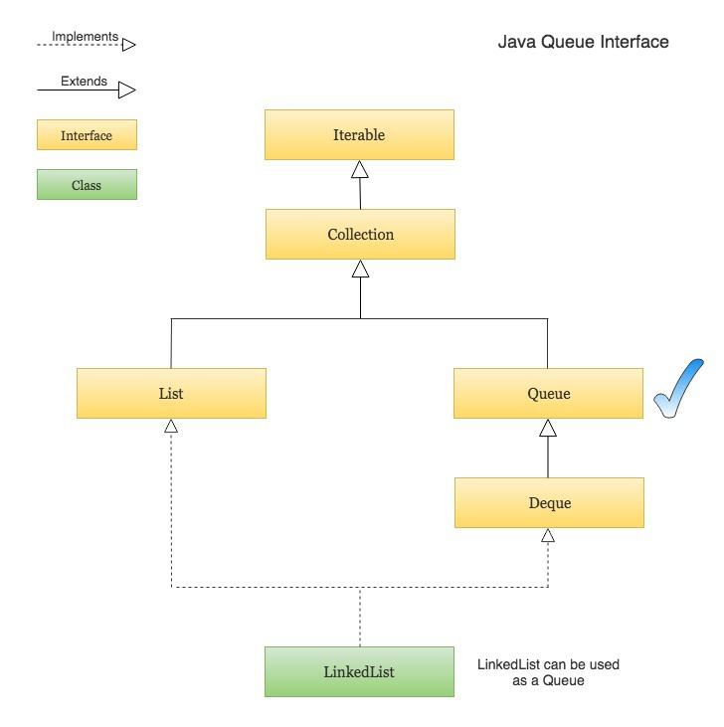
Queue
The process of adding an element at the back of the Queue is called Enqueue, and the process of removing an element from the front of the Queue is called Dequeue.
Java provides a Queue interface which is part of Java’s collections framework. The figure below depicts the position of Queue interface in Collections hierarchy -
Notes:
Priority Queue is an extension of queue with following properties. Every item has a priority associated with it. An element with high priority is dequeued before an element with low priority. If two elements have the same priority, they are served according to their order in the queue.
A priority queue is typically implemented using Heap data structure. Applications: Dijkstra's Shortest Path Algorithm using priority queue: When the graph is stored in the form of adjacency list or matrix, priority queue can be used to extract minimum efficiently when implementing Dijkstra's algorithm.
<number>

Slide 14
Creating a Queue and Performing basic operations like Enqueue and Dequeue
import java.util.LinkedList;
import java.util.Queue;
public class QueueExample {
public static void main(String[] args) {
// Create and initialize a Queue using a LinkedList
Queue<String> waitingQueue = new LinkedList<>();
// Adding new elements to the Queue (The Enqueue operation)
waitingQueue.add("Rajeev");
waitingQueue.add("Chris");
waitingQueue.add("John");
waitingQueue.add("Mark");
waitingQueue.add("Steven");
System.out.println("WaitingQueue : " + waitingQueue);
// Removing an element from the Queue using remove() (The Dequeue operation)
// The remove() method throws NoSuchElementException if the Queue is empty
String name = waitingQueue.remove();
System.out.println("Removed from WaitingQueue : " + name + " | New WaitingQueue : " + waitingQueue);
// Removing an element from the Queue using poll()
// The poll() method is similar to remove() except that it returns null if the Queue is empty.
name = waitingQueue.poll();
System.out.println("Removed from WaitingQueue : " + name + " | New WaitingQueue : " + waitingQueue);
}
}
# Output
WaitingQueue : [Rajeev, Chris, John, Mark, Steven]
Removed from WaitingQueue : Rajeev | New WaitingQueue : [Chris, John, Mark, Steven]
Removed from WaitingQueue : Chris | New WaitingQueue : [John, Mark, Steven]

Slide 15
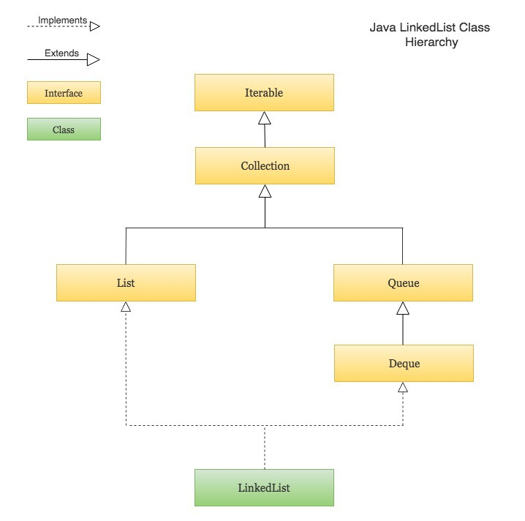
Linked List
Java LinkedList is a doubly linked list implementation of Java’s List and Deque interfaces. It is part of Java’s collections framework. Here is the class hierarchy of LinkedList -

Slide 16
Some key points to note about LinkedList in Java -
Java LinkedList maintains the insertion order of the elements.
LinkedList can have duplicate and null values.
The LinkedList class implements Queue and Deque interfaces. Therefore, It can also be used as a Queue, Deque or Stack.
Java LinkedList is not thread-safe. You must explicitly synchronize concurrent modifications to the LinkedList in a multi-threaded environment.

Slide 17
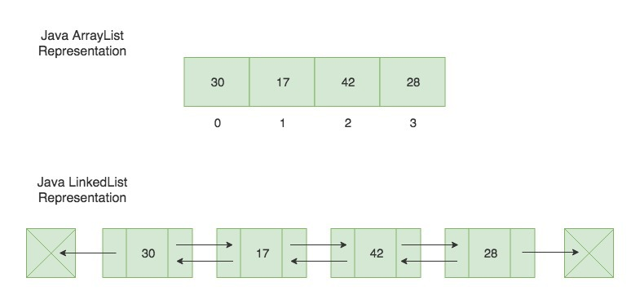
Java ArrayList vs LinkedList
Following are some key points to note about LinkedList in Java -
Java LinkedList maintains the insertion order of the elements.
LinkedList can have duplicate and null values.
The LinkedList class implements Queue and Deque interfaces. Therefore, It can also be used as a Queue, Deque or Stack.
Java LinkedList is not thread-safe. You must explicitly synchronize concurrent modifications to the LinkedList in a multi-threaded environment.

Slide 18
Example
import java.util.ArrayList;
import java.util.LinkedList;
import java.util.List;
public class CreateLinkedListExample {
public static void main(String[] args) {
// Creating a LinkedList
LinkedList<String> friends = new LinkedList<>();
// Adding new elements to the end of the LinkedList using add() method.
friends.add("Rajeev");
friends.add("John");
friends.add("David");
friends.add("Chris");
System.out.println("Initial LinkedList : " + friends);
// Adding an element at the specified position in the LinkedList
friends.add(3, "Lisa");
System.out.println("After add(3, \"Lisa\") : " + friends);
// Adding an element at the beginning of the LinkedList
friends.addFirst("Steve");
System.out.println("After addFirst(\"Steve\") : " + friends);
// Adding an element at the end of the LinkedList (This method is equivalent to the add() method)
friends.addLast("Jennifer");
System.out.println("After addLast(\"Jennifer\") : " + friends);
// Adding all the elements from an existing collection to the end of the LinkedList
List<String> familyFriends = new ArrayList<>();
familyFriends.add("Jesse");
familyFriends.add("Walt");
friends.addAll(familyFriends);
System.out.println("After addAll(familyFriends) : " + friends);
}
}
# Output
Initial LinkedList : [Rajeev, John, David, Chris]
After add(3, "Lisa") : [Rajeev, John, David, Lisa, Chris]
After addFirst("Steve") : [Steve, Rajeev, John, David, Lisa, Chris]
After addLast("Jennifer") : [Steve, Rajeev, John, David, Lisa, Chris, Jennifer]
After addAll(familyFriends) : [Steve, Rajeev, John, David, Lisa, Chris, Jennifer, Jesse, Walt]

Slide 19
Retrieve elements
import java.util.LinkedList;
public class RetrieveLinkedListElementsExample {
public static void main(String[] args) {
// A LinkedList containing Stock Prices of a company for the last 6 days
LinkedList<Double> stockPrices = new LinkedList<>();
stockPrices.add(45.00);
stockPrices.add(51.00);
stockPrices.add(62.50);
stockPrices.add(42.75);
stockPrices.add(36.80);
stockPrices.add(68.40);
// Getting the first element in the LinkedList using getFirst()
// The getFirst() method throws NoSuchElementException if the LinkedList is empty
Double firstElement = stockPrices.getFirst();
System.out.println("Initial Stock Price : " + firstElement);
// Getting the last element in the LinkedList using getLast()
// The getLast() method throws NoSuchElementException if the LinkedList is empty
Double lastElement = stockPrices.getLast();
System.out.println("Current Stock Price : " + lastElement);
// Getting the element at a given position in the LinkedList
Double stockPriceOn3rdDay = stockPrices.get(2);
System.out.println("Stock Price on 3rd Day : " + stockPriceOn3rdDay);
}
}
# Output
Initial Stock Price : 45.0
Current Stock Price : 68.4
Stock Price on 3rd Day : 62.5

